Slide 1
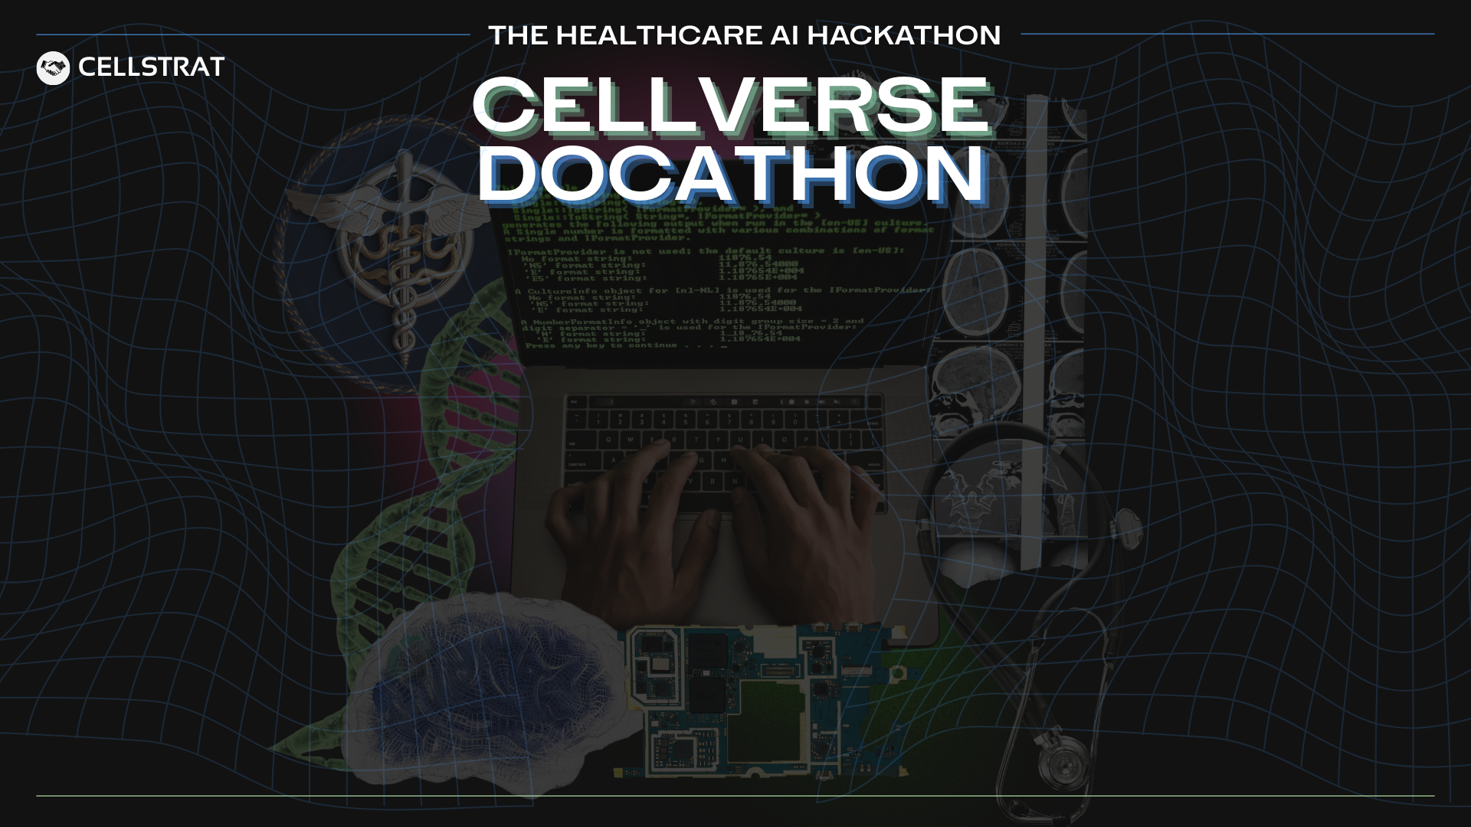
Team 23 - AlzBot
Team Details
Engg Team Member 1 (Leader):
Durgesh Babu P
Organization Name:
Rajarajeswari College of Engineering
durgeshbabu5863@gmail.com
Engg Team Member 2:
Manish K Jain
Email Id (Team Leader):
Contact Number (Team Leader):
S Arthi
8438529357
Engg Team Member 3:
Engg Team Member 4:
Gagan KM
Medical Team Member 1:
Dayananda Sagar College
Priyanka MR
Organization Name:
Medical Team Member 2:
Samantha Tresa
Email Id (Team Leader):
priyankamunirajreddy@gmail.com

Slide 2
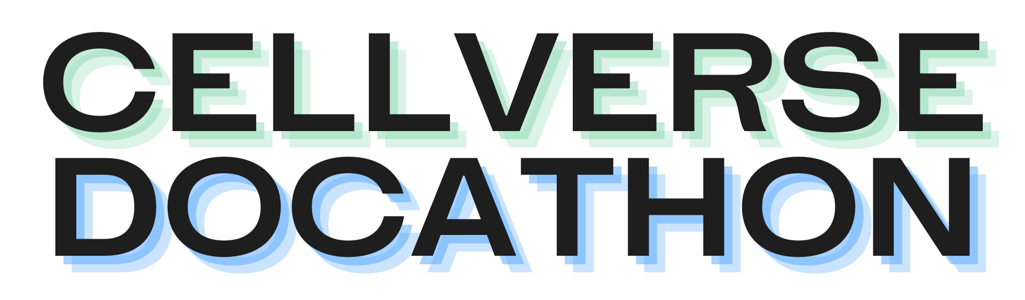
Problem Statement
What is the challenge you're solving?
Alzheimer’s is often diagnosed too late, when significant brain damage has already occurred. Early symptoms like minor speech changes or eye movement shifts are subtle and usually missed in routine exams. We aim to solve this by using AI to detect these early signs through non-invasive inputs like speech and gaze
Why is the problem important?
Early detection of Alzheimer’s can delay its progression and help patients maintain independence for longer. Since there’s no cure, identifying the disease early allows for better planning, treatment, and support. Without early diagnosis, families and healthcare systems face higher emotional and financial burdens.
Who is affected and how?
Alzheimer’s affects over 50 million people worldwide, most of them over age 65. It causes memory loss, confusion, and decline in thinking and daily functioning. Family members are bound to stress, burnout, and financial strain. Healthcare providers also struggle with late-stage care demands.
Any data, numbers, or real-world context you can share?
According to the WHO, Alzheimer’s cases could reach 139 million by 2050. One in nine people over 65 already live with the disease. Dementia costs the world more than $1.3 trillion each year. Traditional diagnosis methods like PET scans or spinal fluid tests are costly and invasive — making early, affordable detection a global need.

Slide 3
Proposed Solution
What solution are you building?
Flask web application designed for Alzheimer's risk prediction using audio data. It allows users to upload audio files or record their cvoice, which are processed to extract features that are then analyzed by a machine learning model to predict the likelihood of Alzheimer's disease. The application provides a user-friendly interface for interaction and displays the prediction results efficiently.
What technology stack are you using?
Key technologies, frameworks, or APIs you plan to use. Example: OpenAI, Groq, HuggingFace, LlamaIndex, Fast API etc.
Type here…

Slide 4
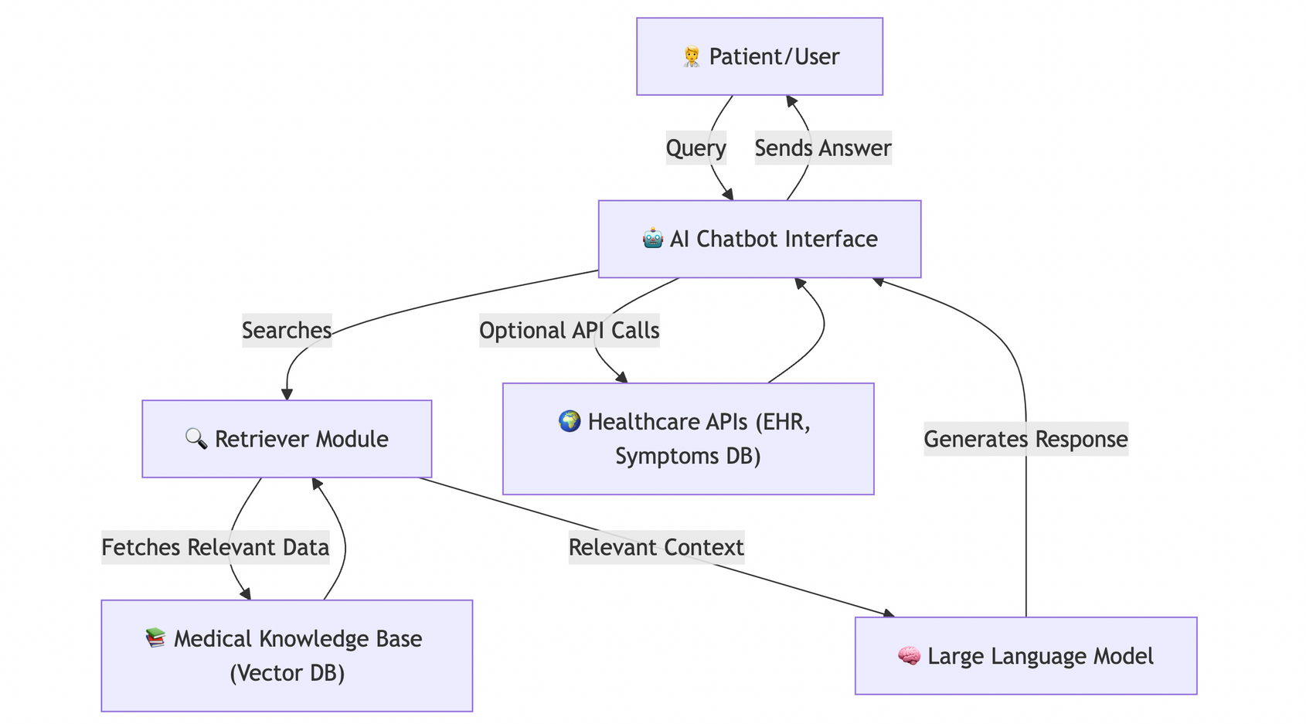
Proposed Solution
Add a visual: solution architecture, workflow sketch, etc.
Add here…
Note: This is only a sample architecture. Please replace with your own solution architecture image.
Any datasets or resources you are using?
Type here…

Slide 5
Impact & Readiness
What real-world impact could this solution create?
The real-world impact of this solution could be significant in the field of healthcare, particularly in early detection and management of Alzheimer's disease. By providing a non-invasive, accessible tool for assessing Alzheimer's risk through audio analysis, this application can facilitate early intervention and monitoring. It empowers healthcare providers and caregivers with a tool to track cognitive changes over time, potentially improving patient outcomes and quality of life. Additionally, it can raise awareness and encourage proactive health management among individuals at risk.
Cost Savings : By providing an automated tool for Alzheimer's risk assessment, healthcare providers can reduce the need for expensive and time-consuming diagnostic procedures. This can lead to significant cost savings for both healthcare systems and patients.
Efficiency Gains : The application streamlines the process of risk assessment by allowing users to upload audio files and receive predictions quickly. This efficiency can improve the workflow for healthcare professionals, enabling them to focus on patient care rather than manual assessments.
Improved Outcomes : Early detection of Alzheimer's risk can lead to timely interventions, potentially slowing disease progression and improving patient outcomes. By facilitating early diagnosis, the solution can enhance the quality of life for individuals at risk and provide valuable data for ongoing research and treatment strategies.
Any cost savings, efficiency gains, or improved outcomes?
Is your prototype ready?
Almost ready. We do need to test it out. As for eye ball tracking, It is in planning stage
Will you be able to demo or present it on May 18?
Yes

Slide 6
Project Implementation Plan
Note: Provide a step-by-step breakdown of tasks and modules you will be implementing over the course of the hackathon (over the two-week long build phase). Mention the core functionalities to be developed.
PROVIDE GITHUB LINK HERE (CODE): ________________________________________________

